Slide 1
Safe & Smart Parking
Lakshmi Vaidiyanathan
Vinothini Pushparaja

Slide 2
Introduction
Finding a safe parking location in a city is challenging.
Different Parking types are also available in a city:
Street Parking
Garage Parking
Auto theft on a parked vehicle is one of the expensive Auto insurance claims.
Predicting a safe parking location is a critical factor for consumers safety as well as insurance provider.
Using statistical methods analyzing crime data from the available open source or government data.

Slide 3
Tools
Title | Information
Data | https://data.seattle.gov/
Software | R Studio
R Studio | Packages – Leaflet, Shiny App,
 | e1071, stats, gplots, lmtest,
 | ROCR, MASS, Stats
Model | Logistic Regression (glm() function in R studio)

Slide 4
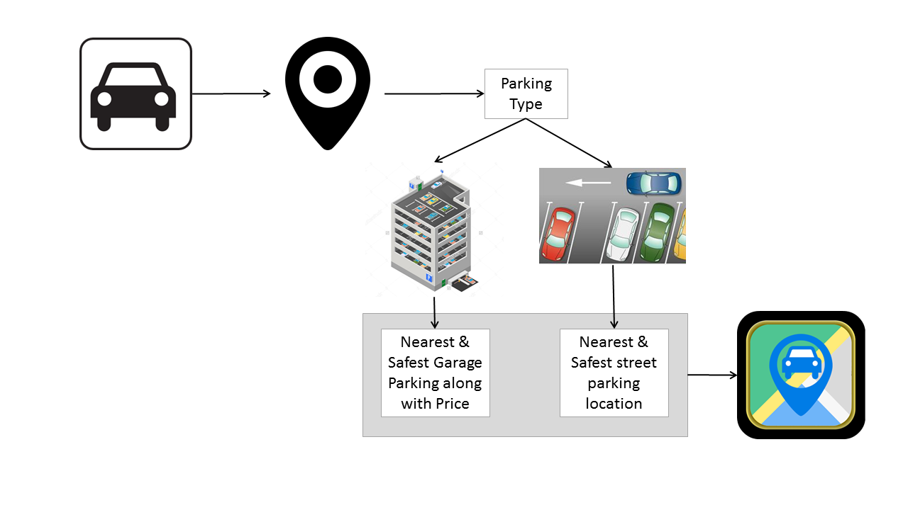
Safe & Smart Parking Architecture

Slide 5
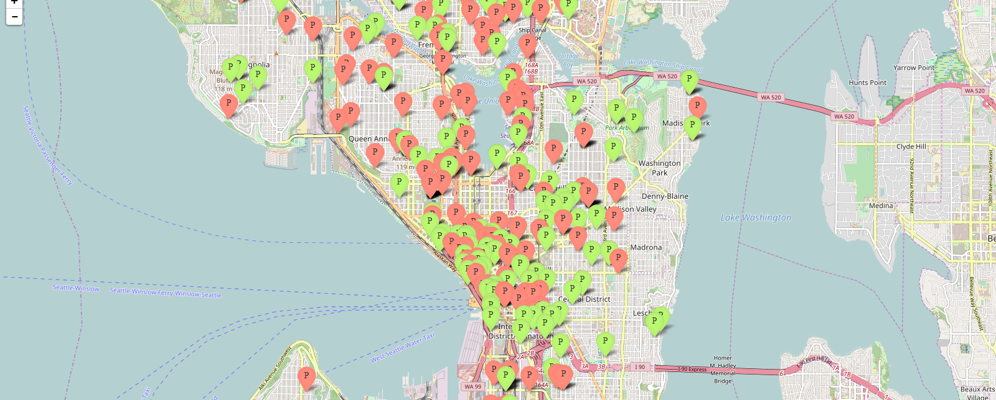
Application Screenshot
Red Marker – Unsafe Parking
Green marker – Safe Parking

